Slide 1
TV
Netflix Cool Findings
Here is where your presentation begins

Slide 2
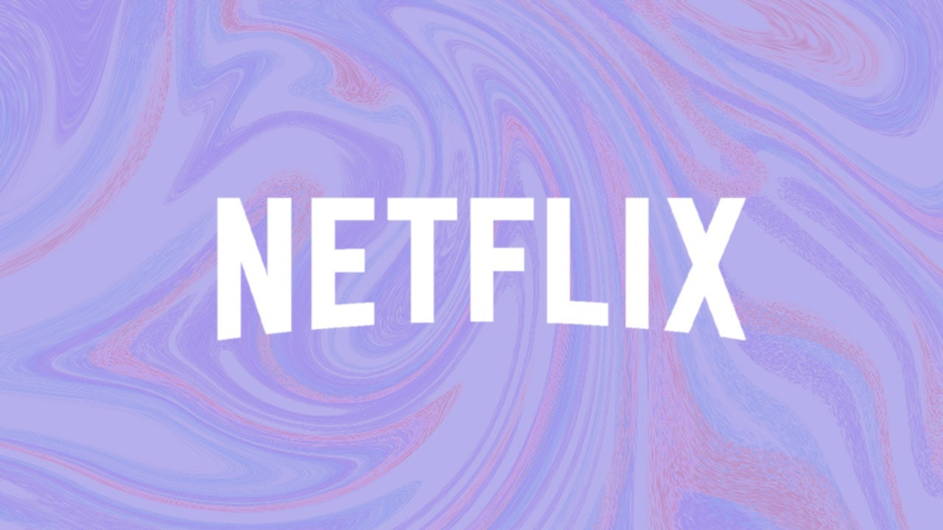
The intro
The purpose of this slideshow is to visually present some cool findings from the Netflix data report. During computations, researchers found out a lot of good information which could better the growth of Netflix and content consumption.

Slide 3
Whoa!
The most amount of content on Netflix is from the years 2022 and 2023!
That is a whole 18.16% of EVERYTHING on Netflix!

Slide 4
Someone Famous
There are 19,861 tv shows/movies in the netflix database.
There are 15,334 movies.
There are 62 family genre content.
Researchers find that 0.312% of tv/shows and movies are of the family genre (very little)

Slide 5
Netflix’s high expectations (conditional style)
Conditional prob time
78% of movies that are going in for review have a rating over 8. In other words, movies with higher ratings (over 8) are more likely to be selected for review compared to movies with lower ratings (under 6). The movies for review are likely to be added to the Netflix catalog.

Slide 6
Bounds
Researchers found the lower bound of the movies with ratings 0.02 to 0.05 is 4.56. So approximately, 5 movies (if rounded) will be in the lower bound of that. So, this means that at least five movies will have a rating of 2 to 5. Movies with lower ratings (2–5 range) tend to not have high traffic and bad reviews.
Netflix prefers picking higher rated content, but some lower-rated movies still make it into the catalog if deemed necessary. The pull of the data: (the 6 movies) tends to be in the lower range. (1, 2, 3, 2, 5, 3)

Slide 7
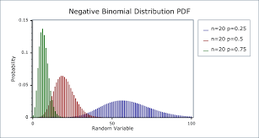
Negative binominal time
Okay, so we found that 42% of movies in the pull had a rating above 8. After computing negative binominal, it was found by the 10th movie there was a 8.03% chance that 3 movies that were picked were over the rating 8.
This just shows that the algorithm just spits out what it wants, and it may not be quality. With the immense amount of movies on Netflix, many are not over rating 8. So users are more likely to see 8 and below.

Slide 8
Randomness of users picking content
Researchers find that 67% of the cases show only one year being correlated correctly. 33% of the time shows no outcome being correct in the listing. 17% of the time shows all three choices being arranged correctly.
This shows the randomness of users choosing what to watch on Netflix. Most of the time (67%) users will pick at least one movie that the algorithm suggests (say: based off the year). Then, secondly, they do not watch or choose any of the content shown by year (33%). Thirdly, the least common is when 17% of the time they pick all three of the media presented based off of attributes like year.

Slide 9
Thank you!
Yay Netflix
Please keep this slide for attribution.

